Slide 1
ImpactTB/BAA Data Collection and Report Templates for CSU
Brooke Anderson
Associate Professor, Environmental & Radiological Health Sciences
Colorado State University

Slide 2
Key processes in data pipelines
Recording research data
Preprocessing research data
Analyzing research data
Integrating different types of research data

Slide 3
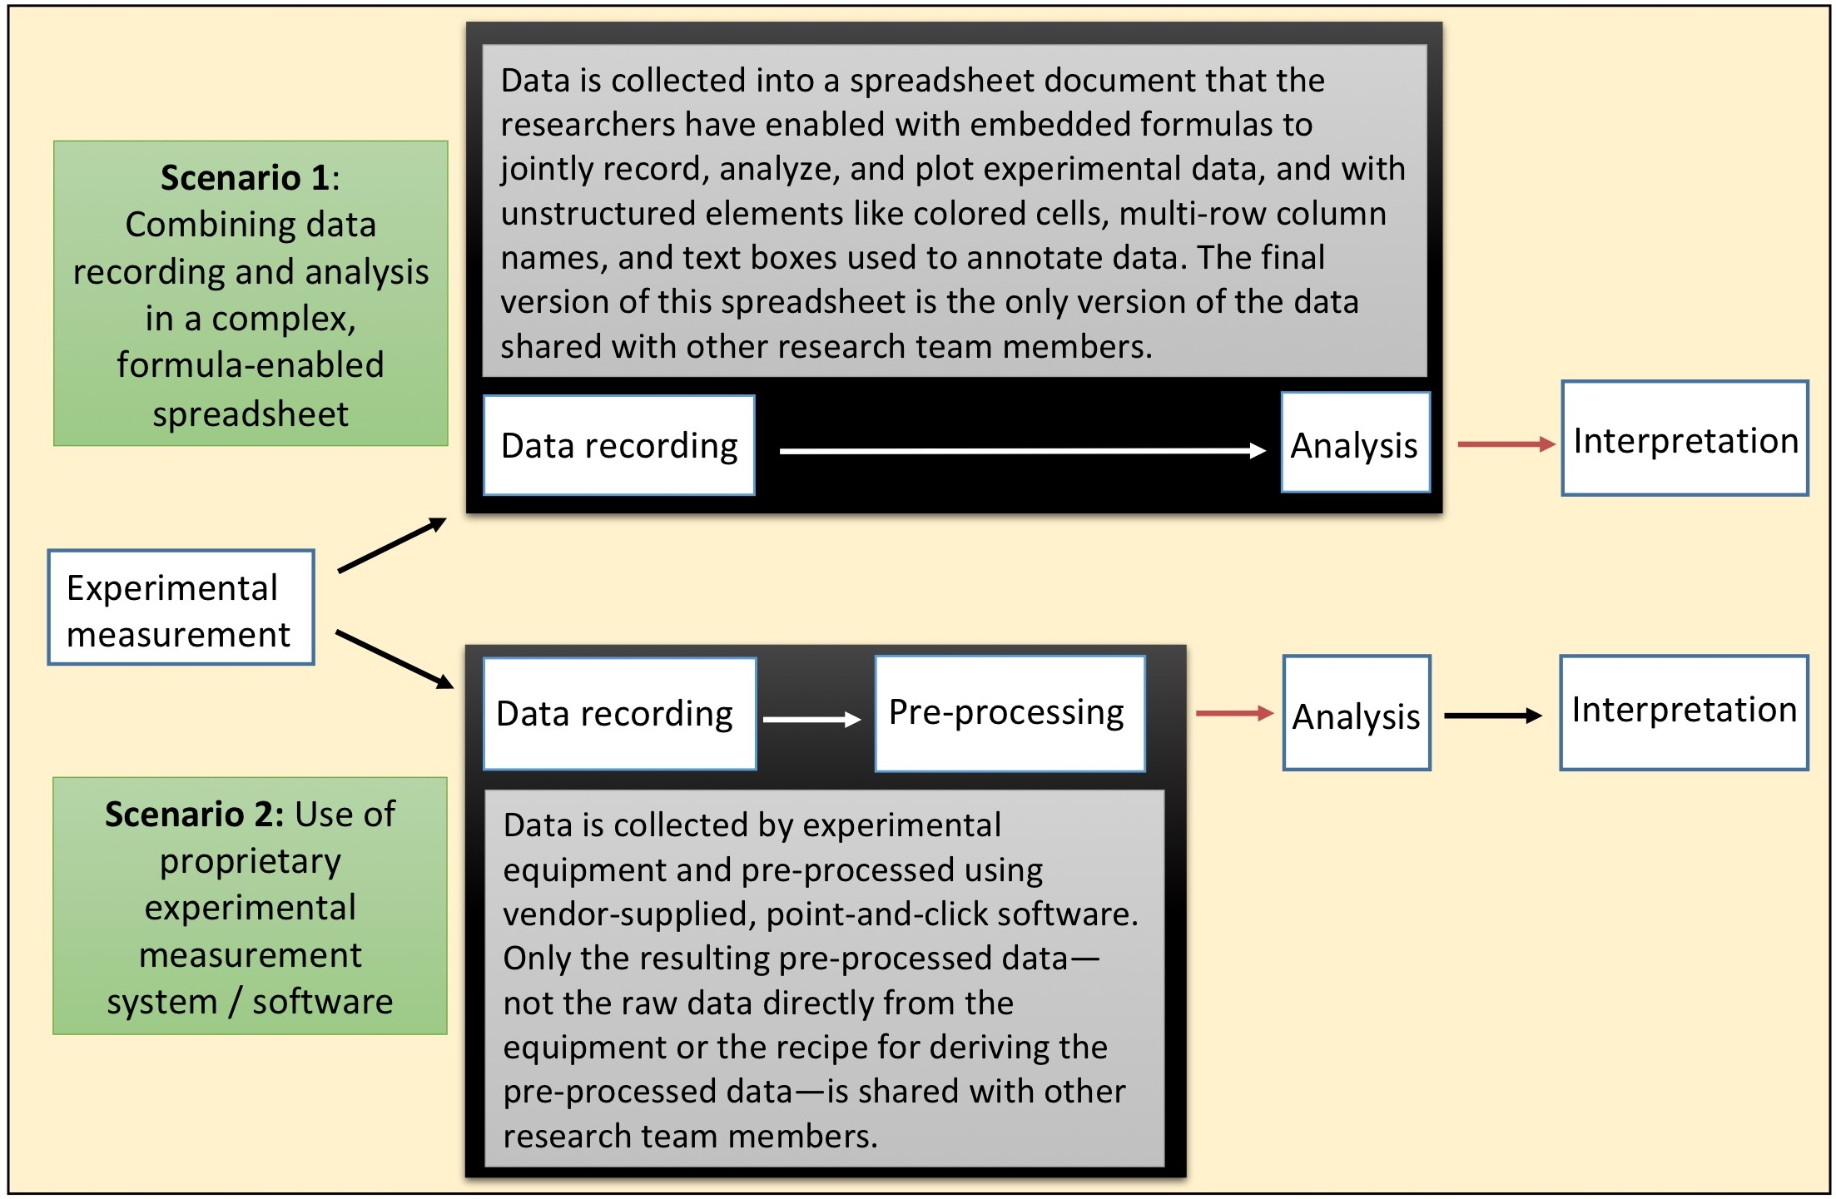

Slide 4
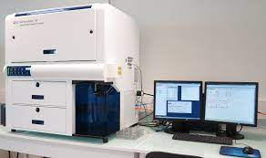
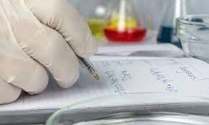
Classes of data recording
Data recorded "by hand”
Example: Lab notebook
Data recorded by equipment
Common file format
Example: Spreadsheet
Specialized file format
Example: .fcs
Ways research data are recorded

Slide 5
Separating data recording from analysis
Complex spreadsheets are often use to both record and analyze research data
There are several limitations with this approach
We aim to separate the steps of data recording and data analysis, with recording in simple templates and analysis through code scripts
I’ll be briefly walking through an example that we’ve developed for an online training module on rigor and reproducibility in data recording and preprocessing: https://geanders.github.io/improve_repro/2.4-module4.html#module4

Slide 6
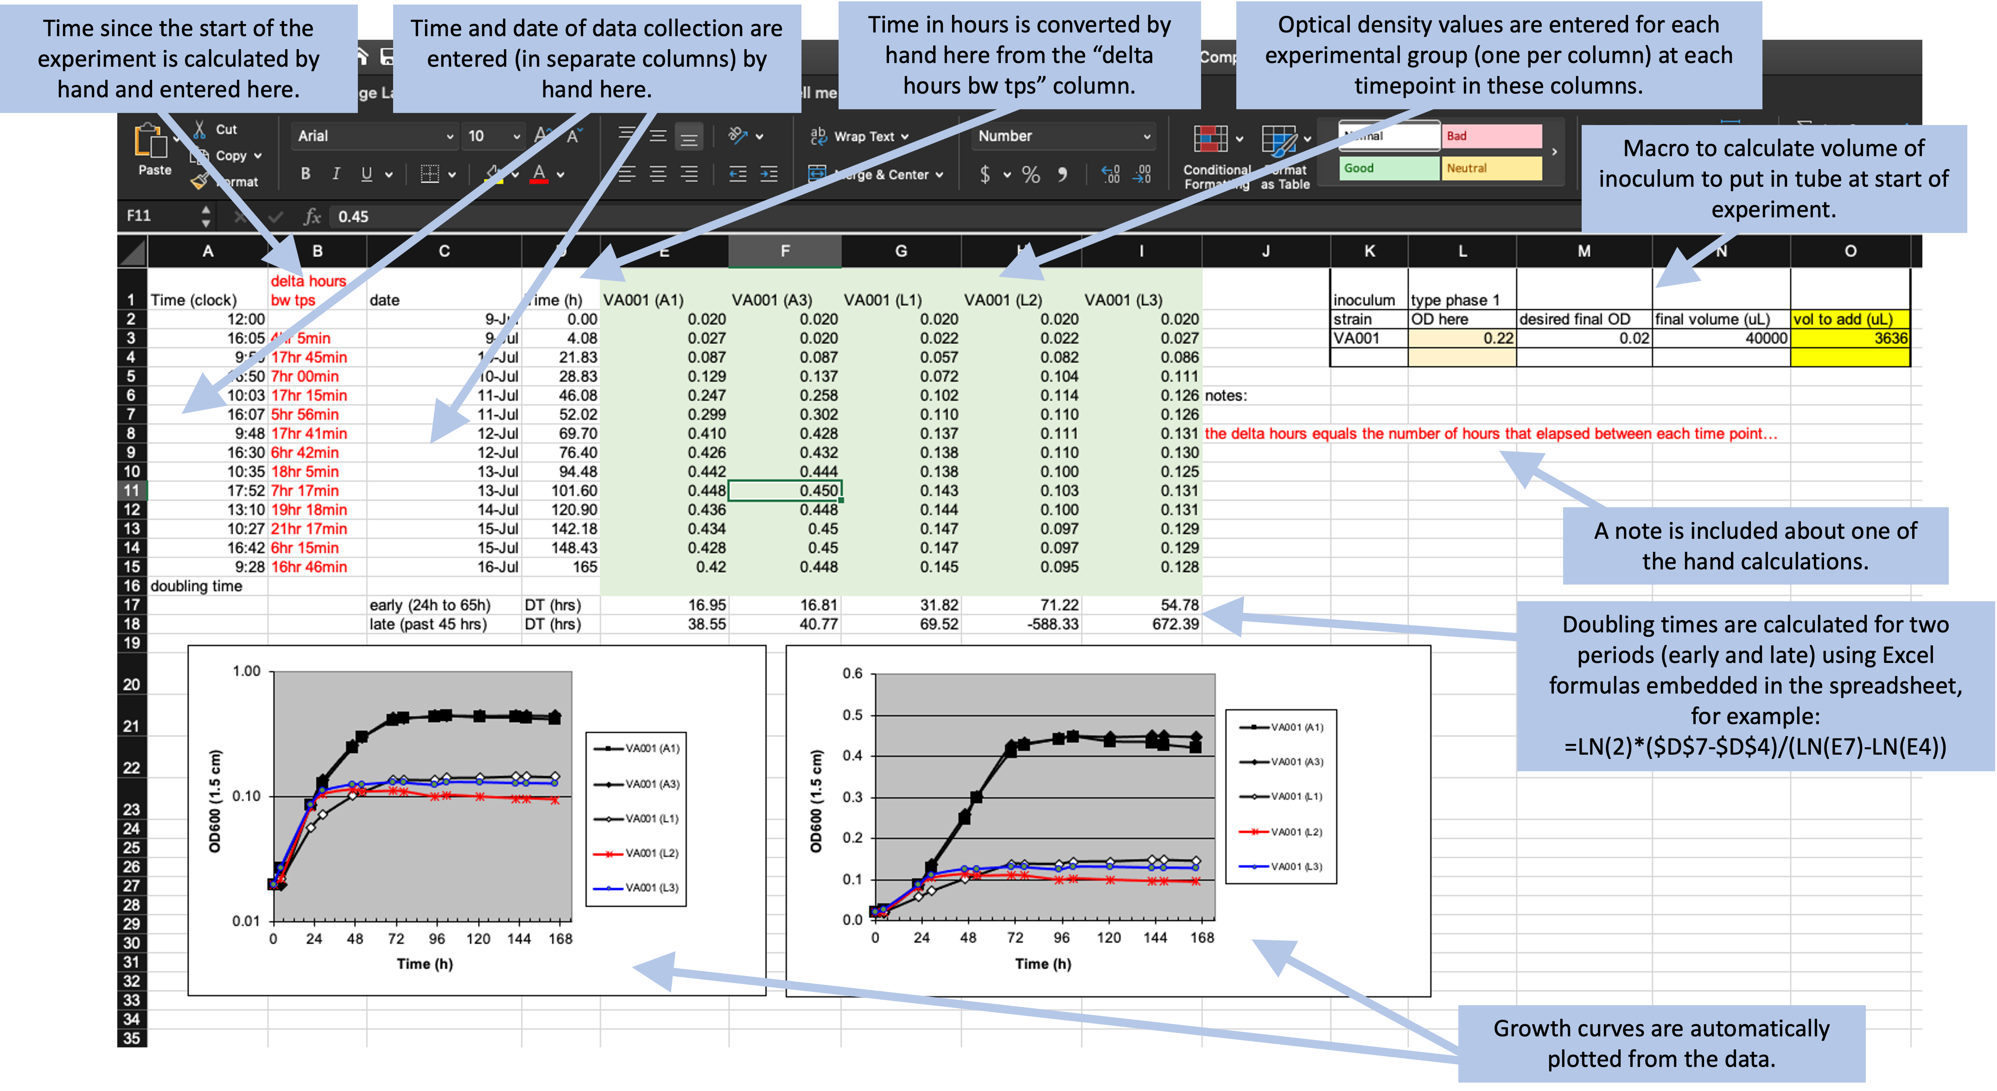

Slide 7
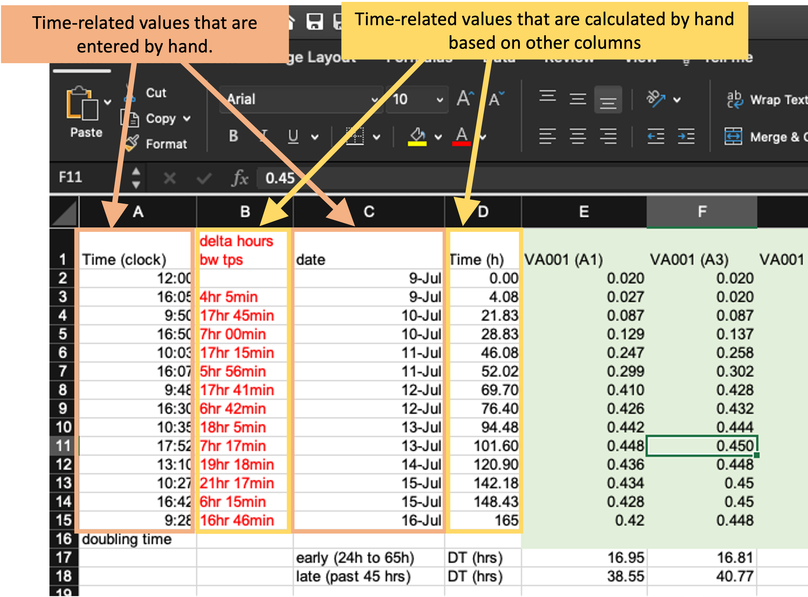
Embedded formulas and macros make it hard to see the underlying logic, and calculations by hand introduced the chance for error

Slide 8
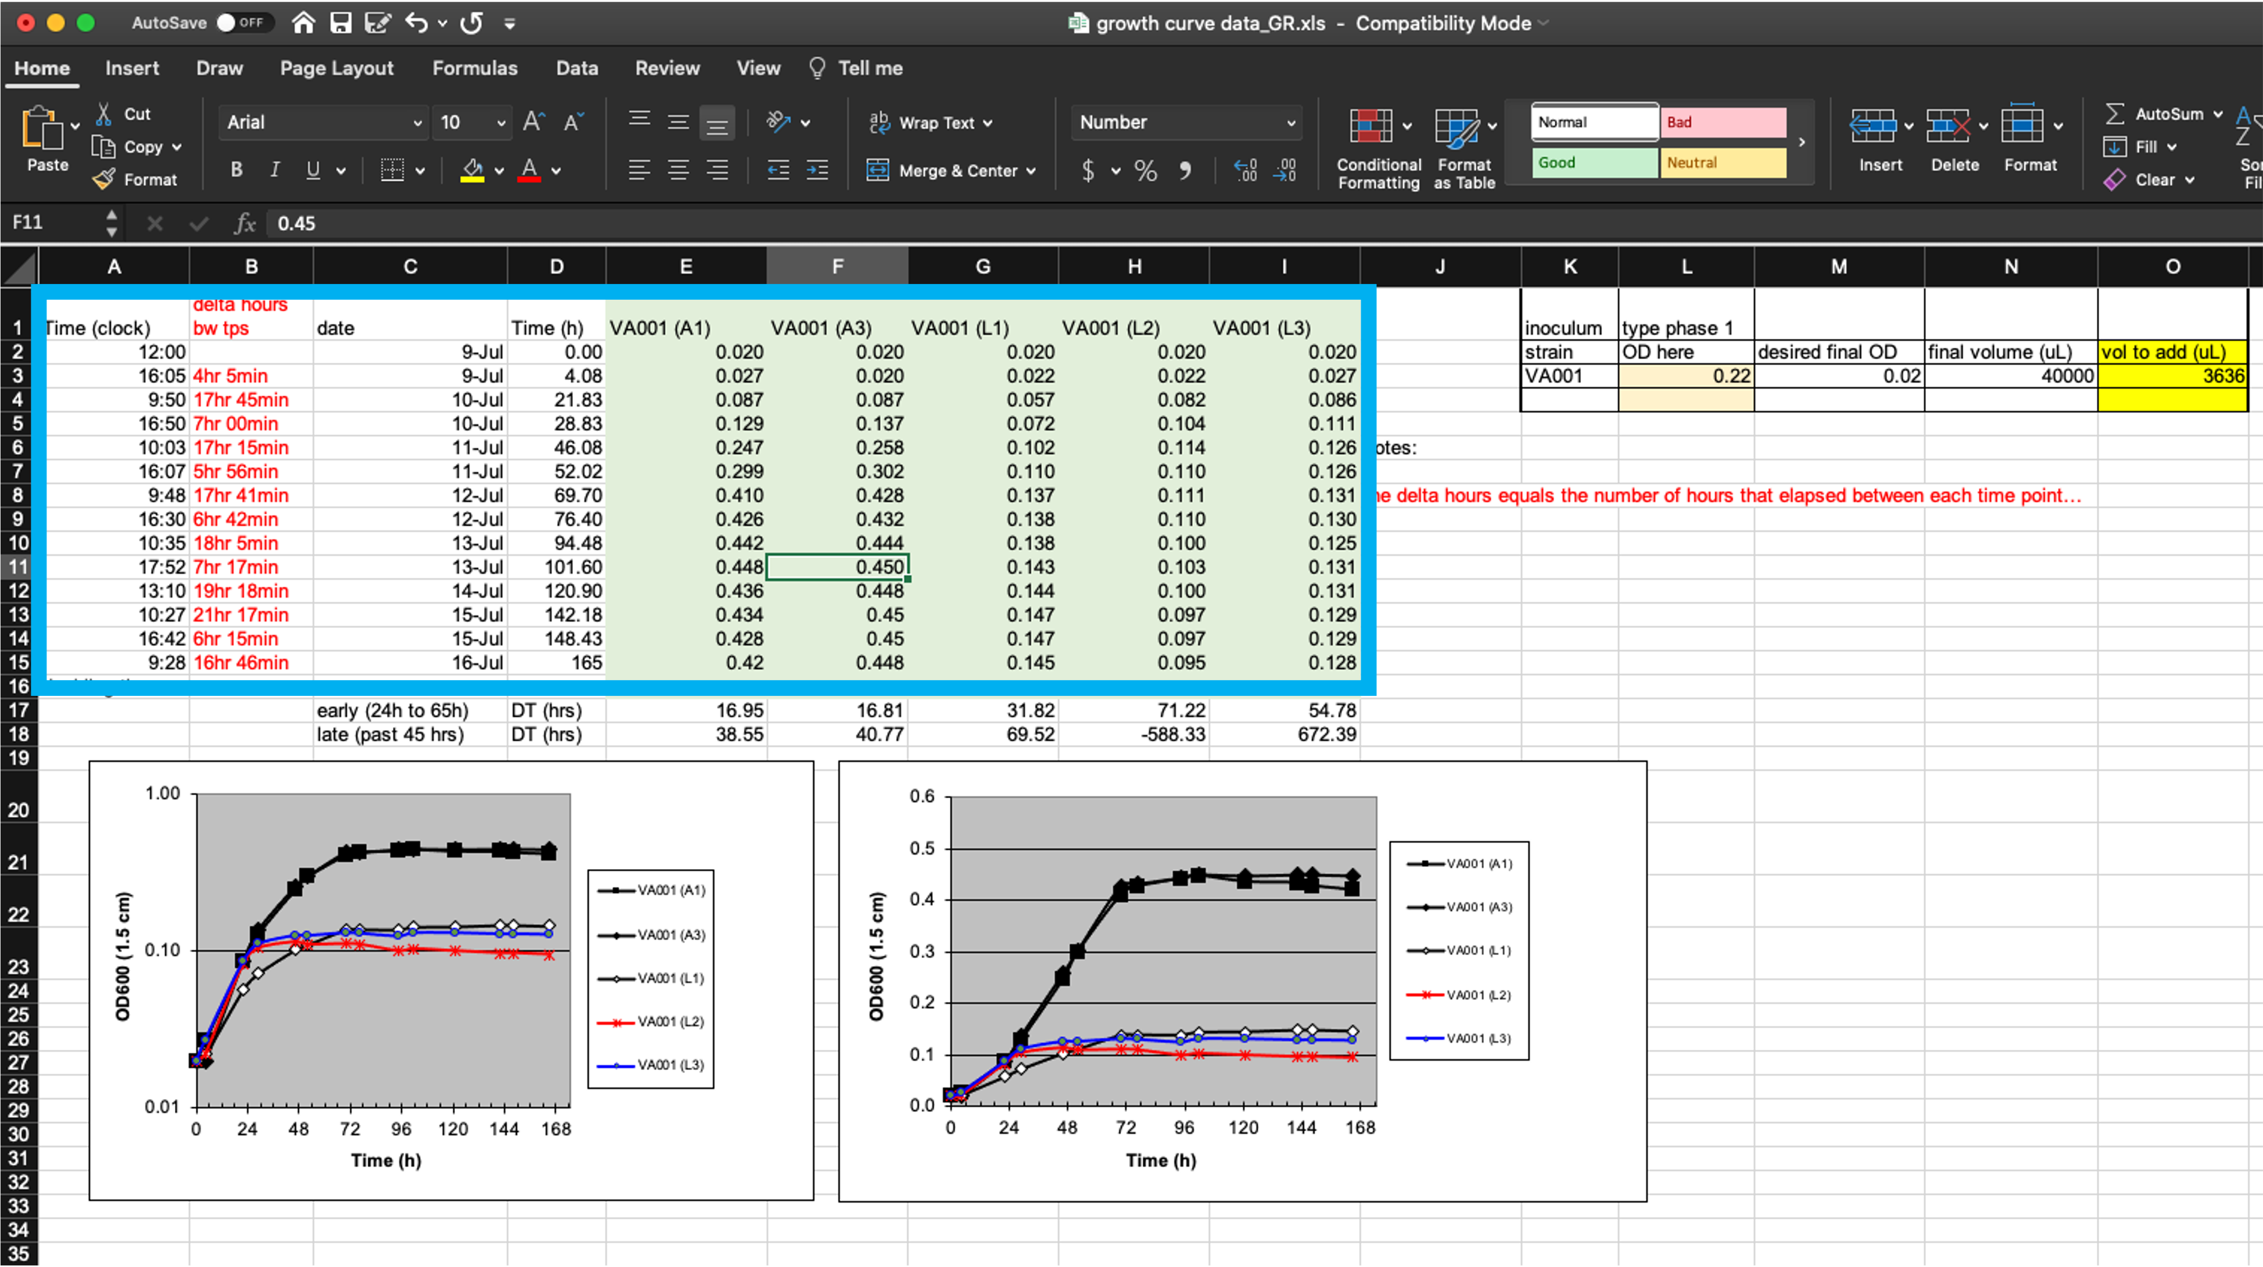
Complex design makes it hard to extract original data for integrative work

Slide 9
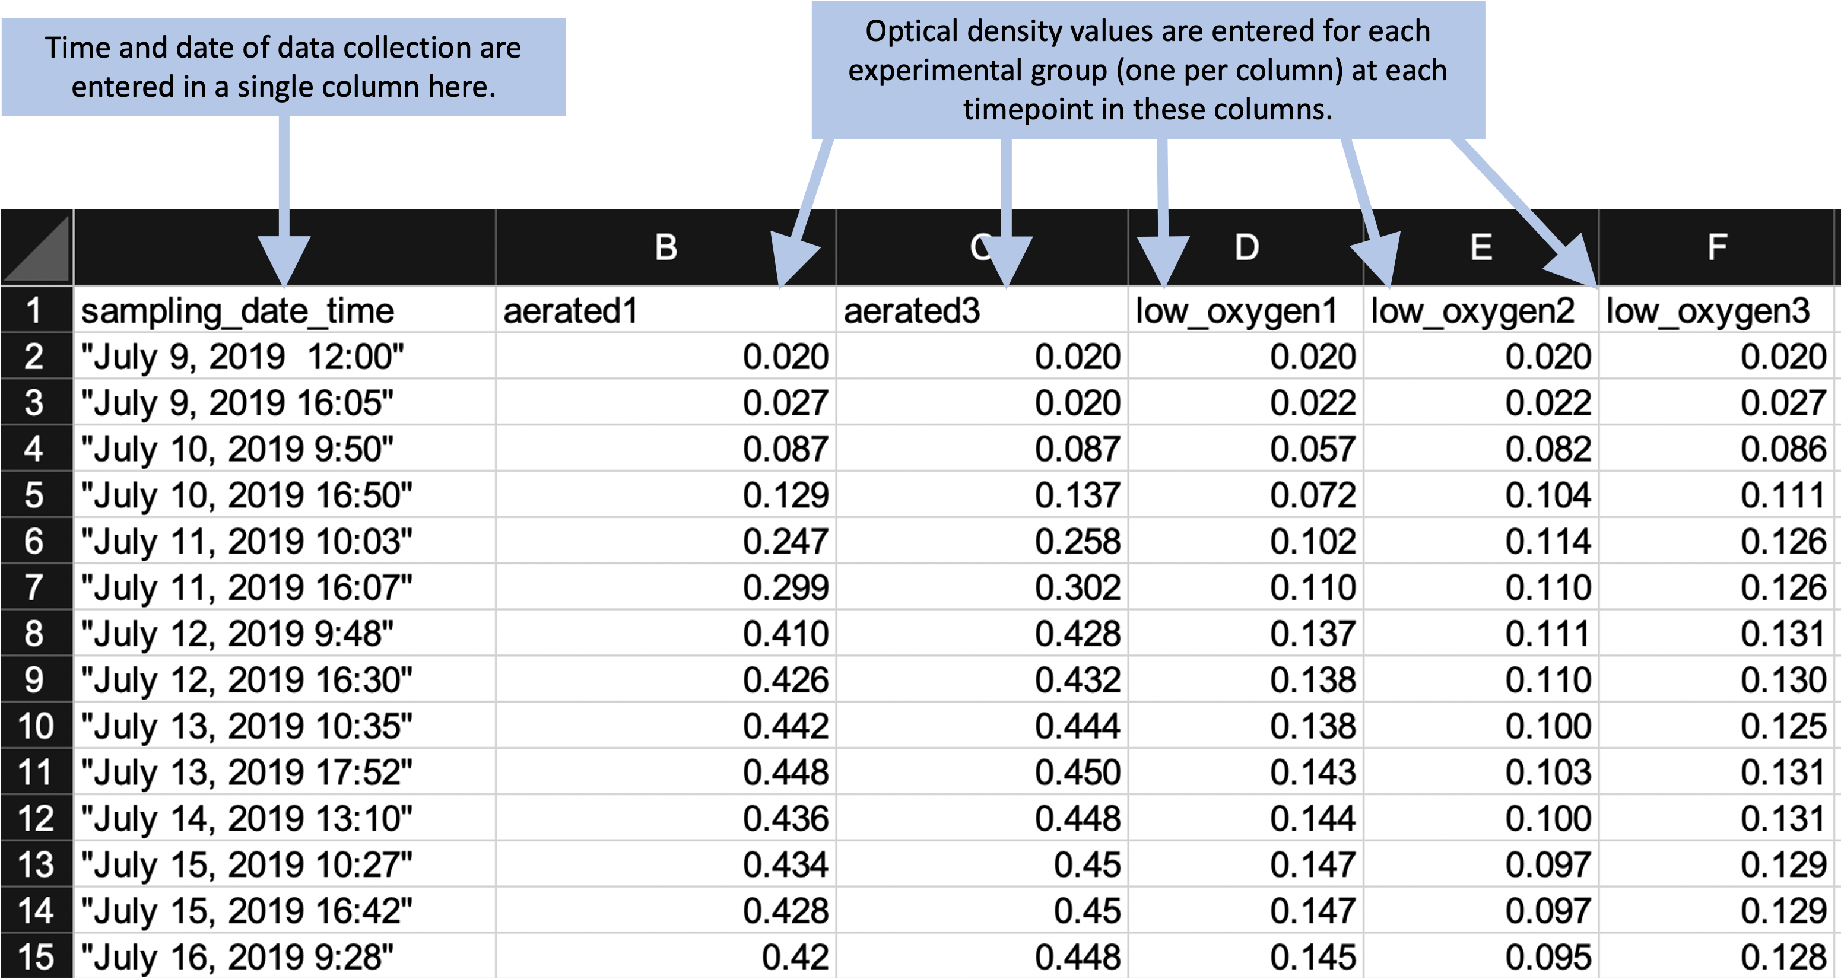
Data collection template is simplified…

Slide 10
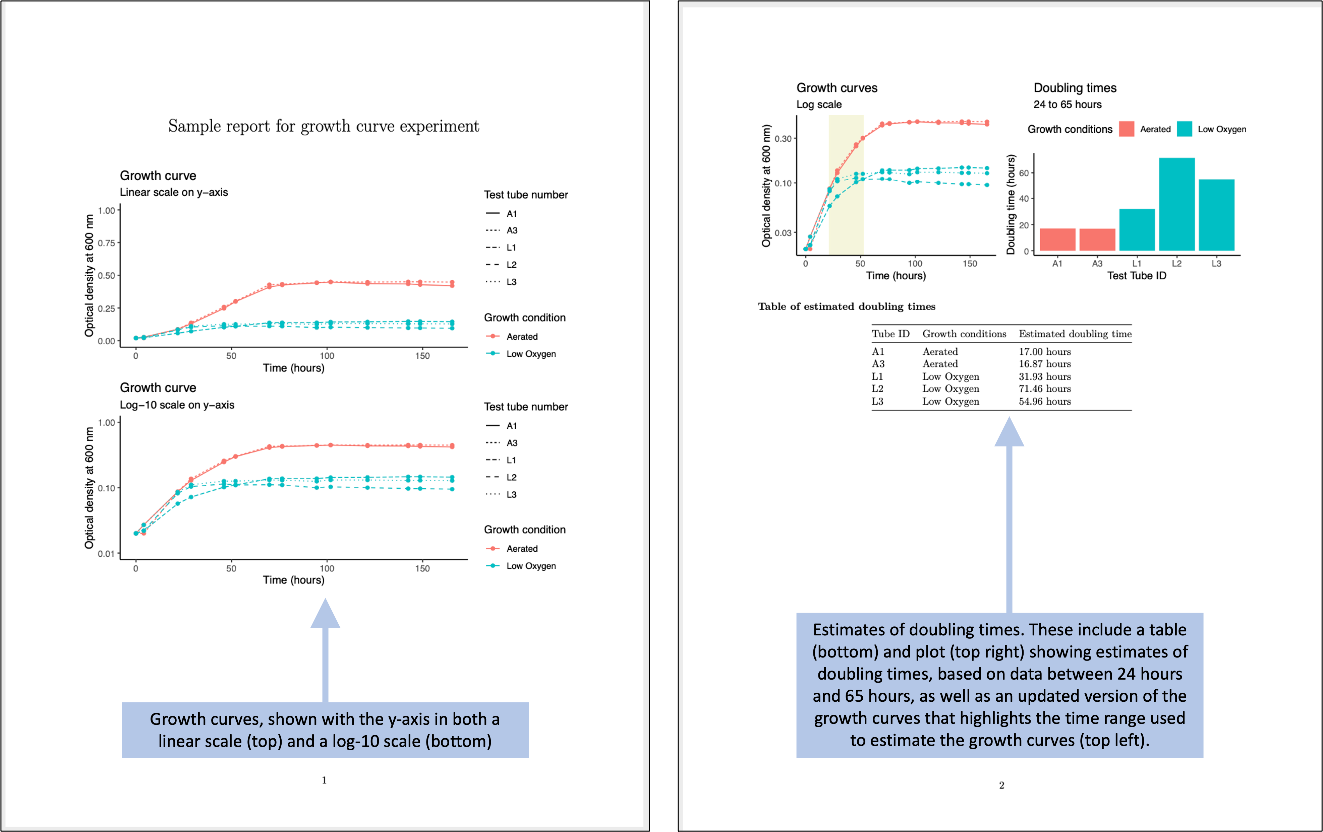
… and analysis and visuals are moved into a script-based report

Slide 11
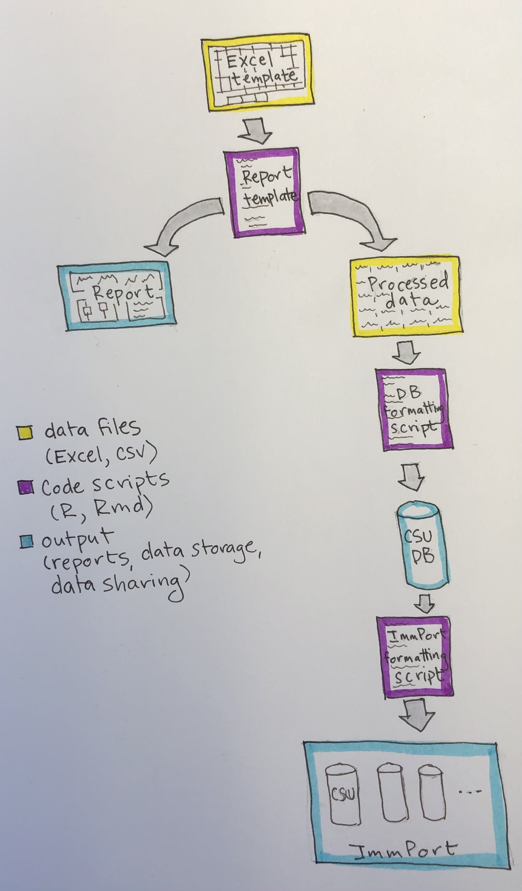
Pipeline overview
Moves from data collection, to experiment-specific data processing / analysis / reporting, to formatting and storing the processed data in a CSU database, to formatting and storing data in a cross-institute database (leveraging ImmPort)
Moves from data / experiment-specific to more generalizable
Early steps can be customized to the institute / experiment / data type, while later steps standardize across experiments to allow for integrative modeling

Slide 12
What are the templates?
Data collection template allows us to separate data collection from data processing and analysis
Rapid report generation helps to monitor experiments
Reproducible reporting tools allow for customization of reports
Allows early analysis and reporting to be customized to a site / experiment while using later steps to standardize for integration across sites / experiments

Slide 13
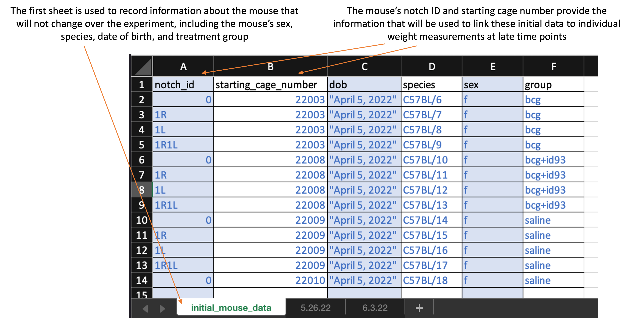
What are the templates?

Slide 14
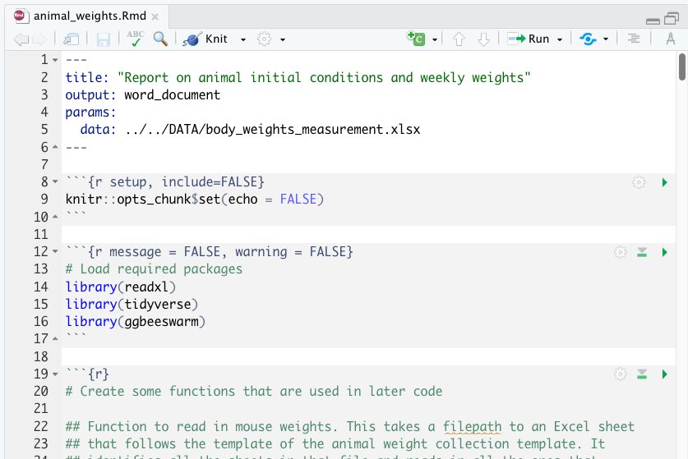
What are the templates?

Slide 15
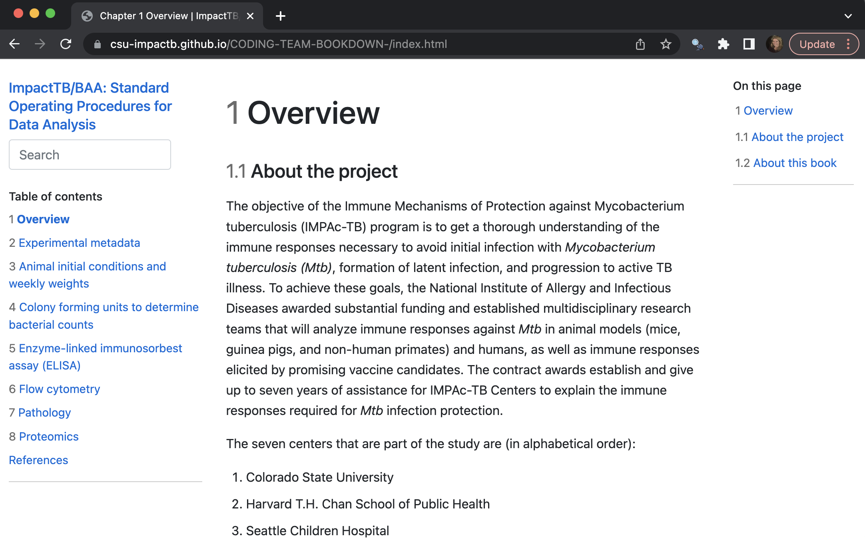
Where to get the templates?
https://csu-impactb.github.io/CODING-TEAM-BOOKDOWN-/index.html

Slide 16
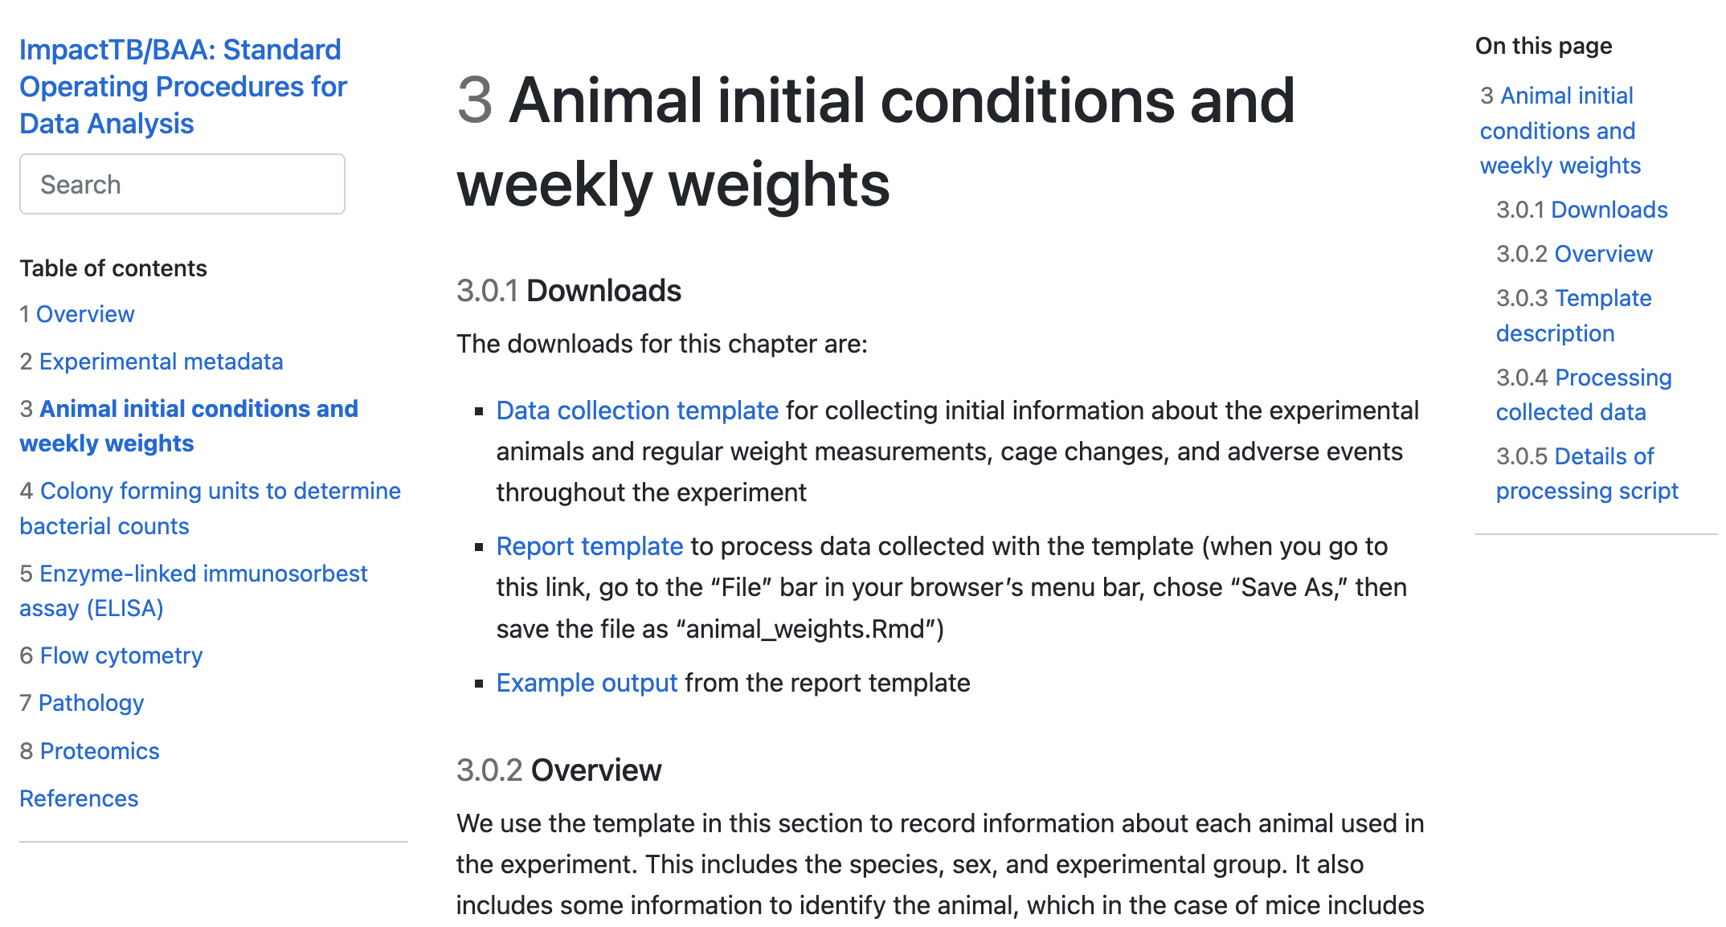
Where to get the templates?
https://csu-impactb.github.io/CODING-TEAM-BOOKDOWN-/animal-initial-conditions-and-weekly-weights.html

Slide 17
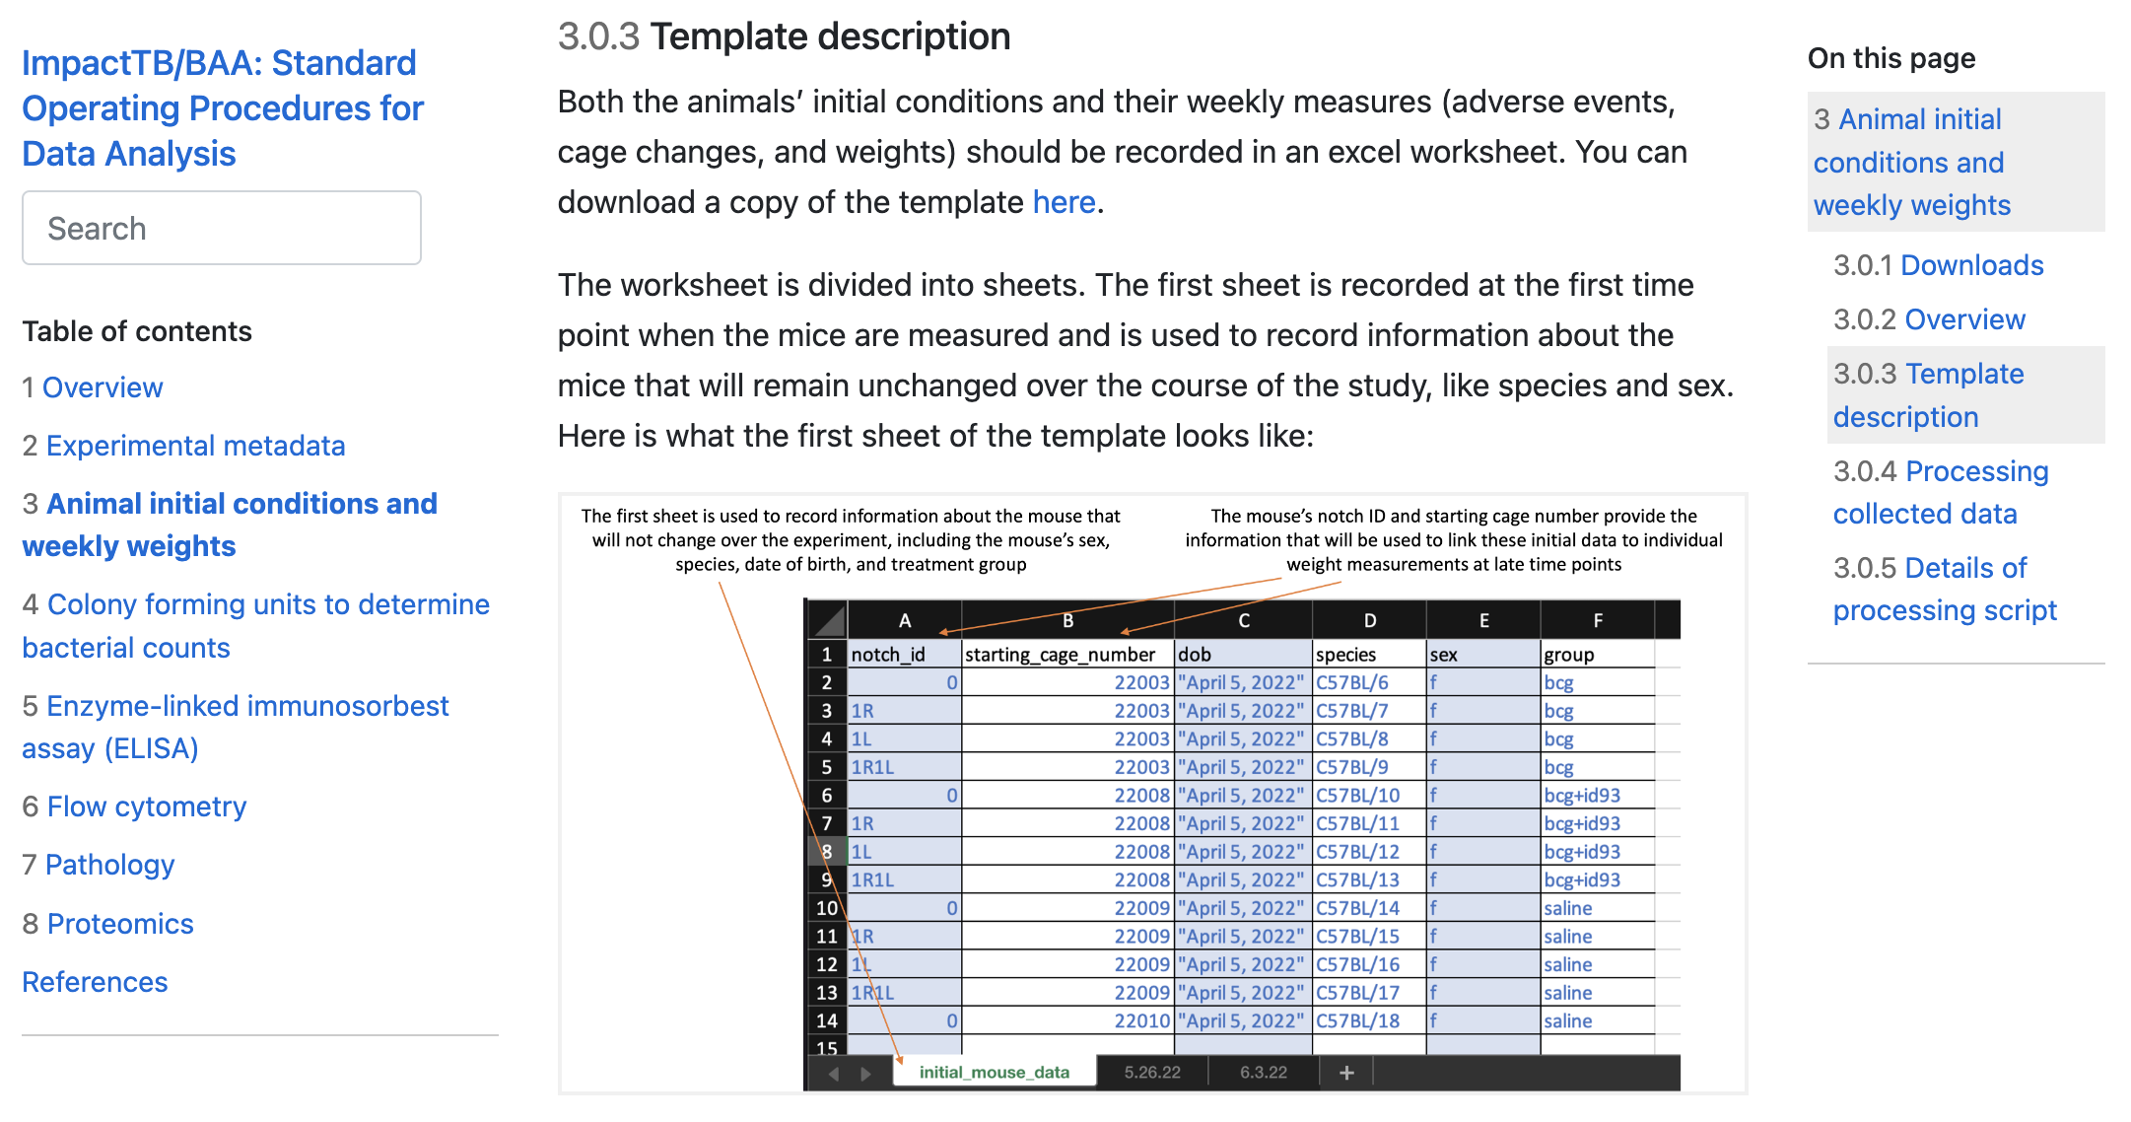
How to use the templates
https://csu-impactb.github.io/CODING-TEAM-BOOKDOWN-/animal-initial-conditions-and-weekly-weights.html

Slide 18
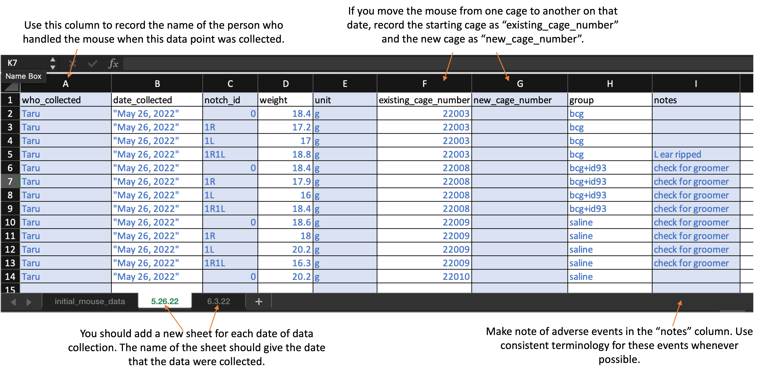
How to use the templates

Slide 19
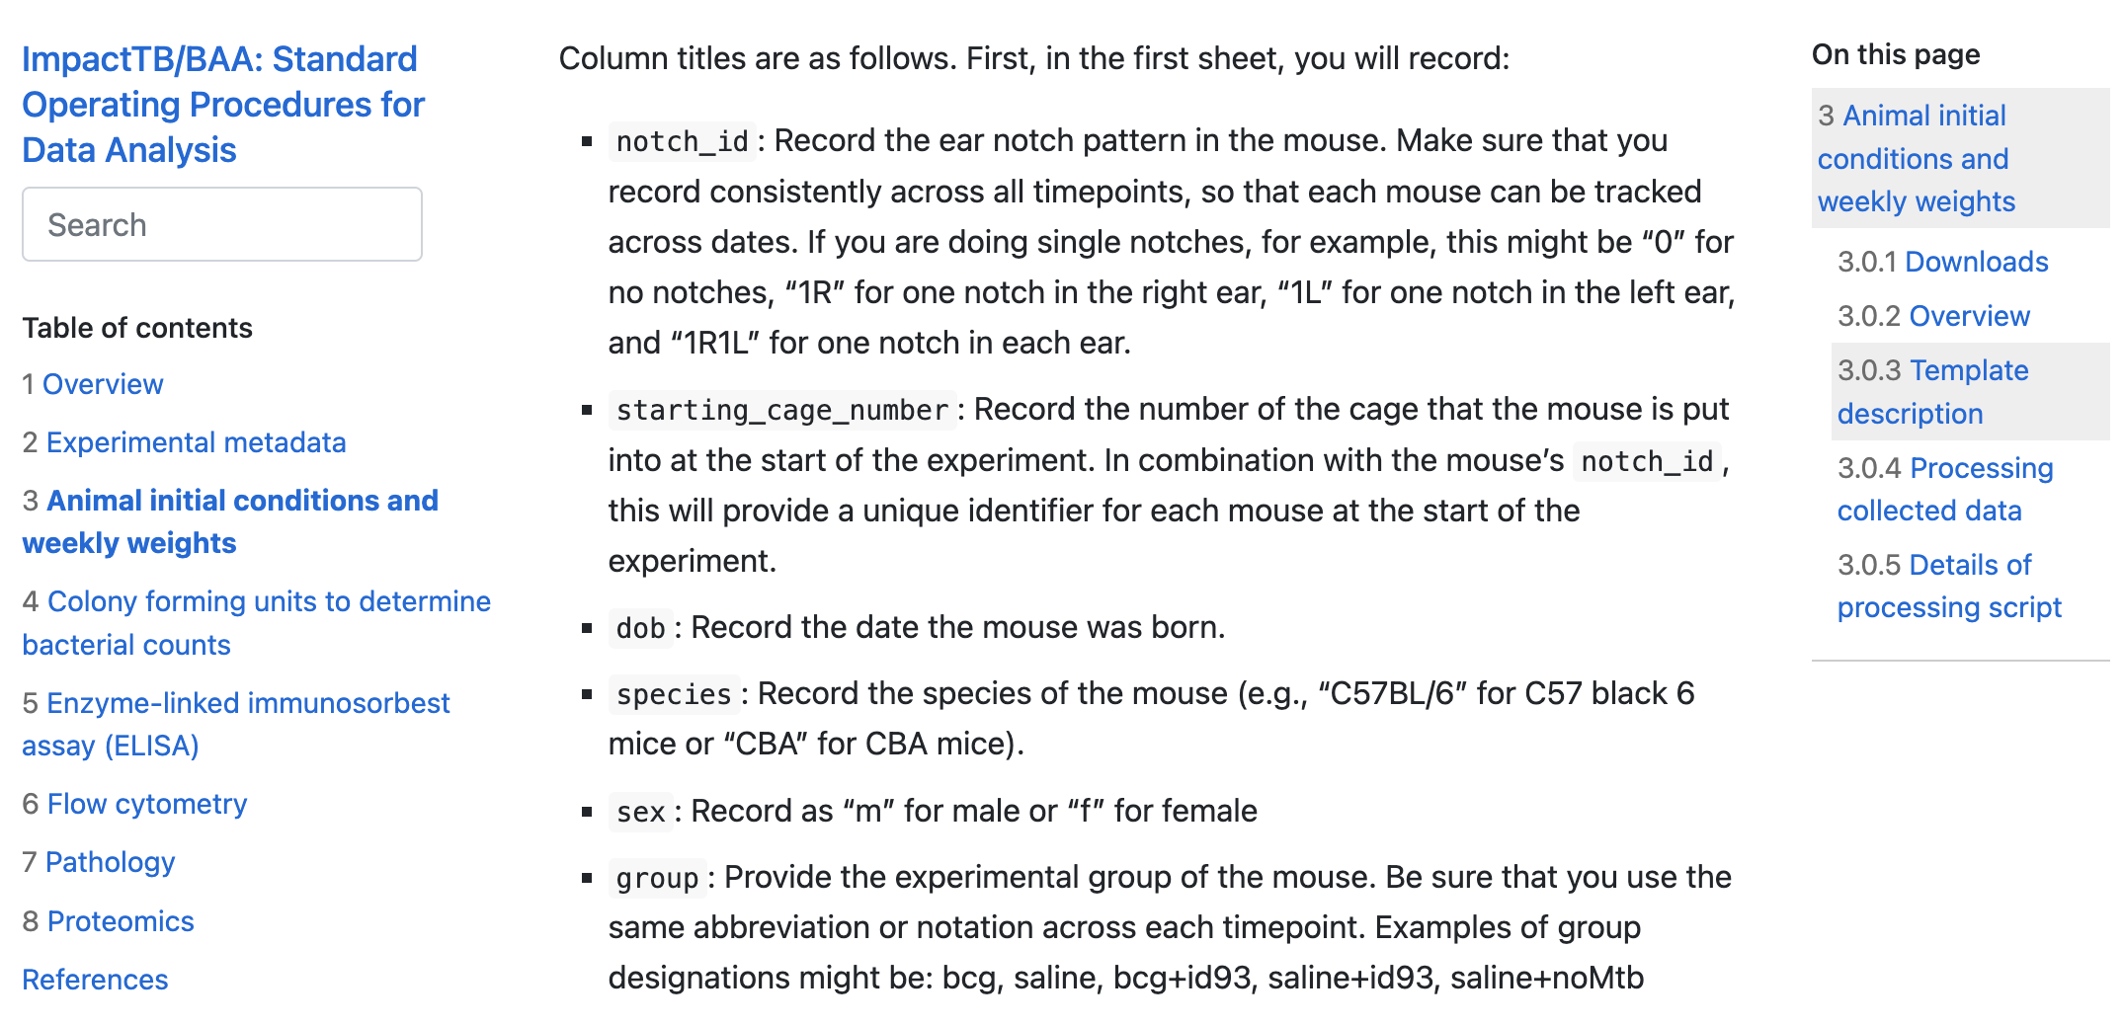
How to use the templates
https://csu-impactb.github.io/CODING-TEAM-BOOKDOWN-/animal-initial-conditions-and-weekly-weights.html

Slide 20
How to use the templates
https://csu-impactb.github.io/CODING-TEAM-BOOKDOWN-/animal-initial-conditions-and-weekly-weights.html

Slide 21
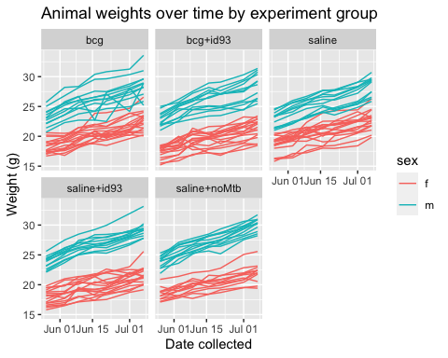
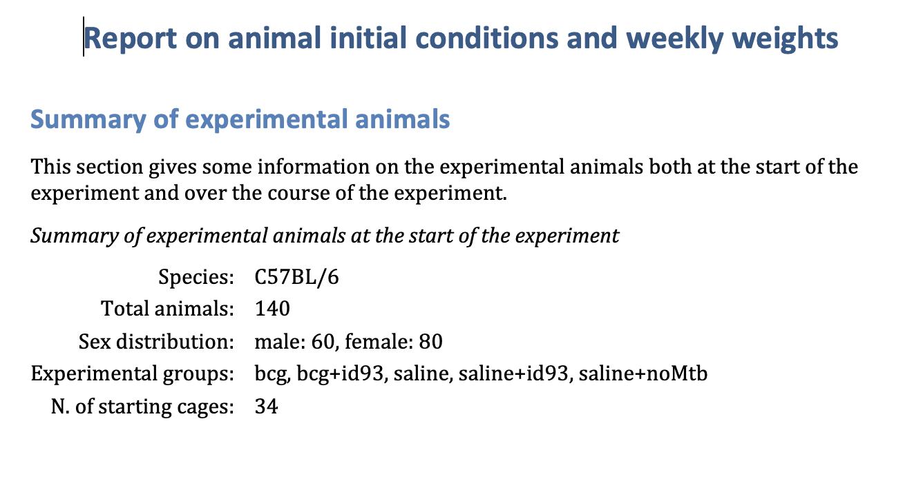
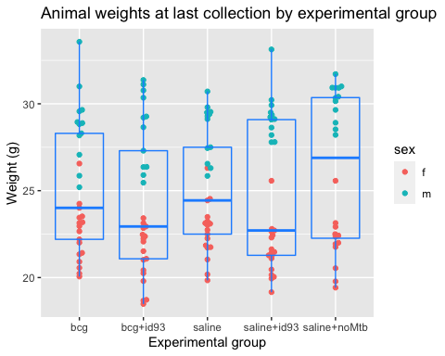
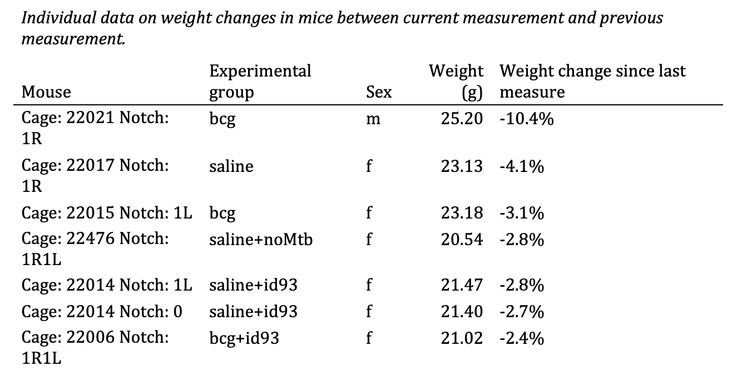
How to use the templates

Slide 22
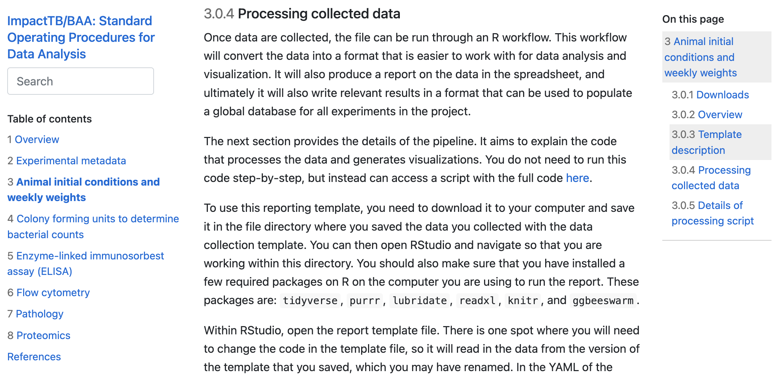
How to use the templates
https://csu-impactb.github.io/CODING-TEAM-BOOKDOWN-/animal-initial-conditions-and-weekly-weights.html

Slide 23
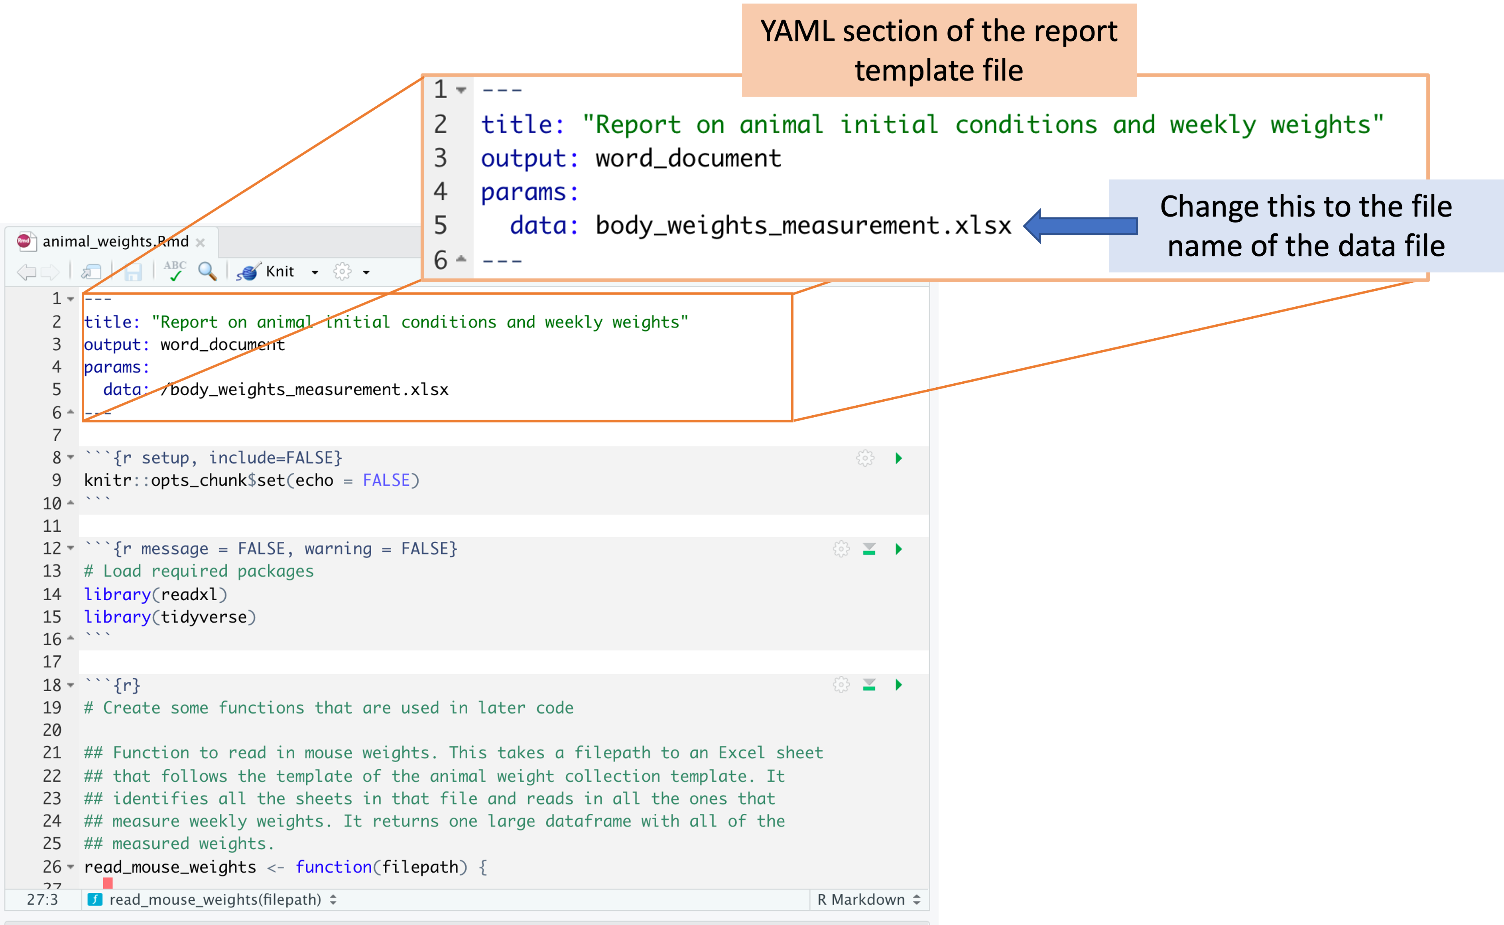
How to use the templates

Slide 24
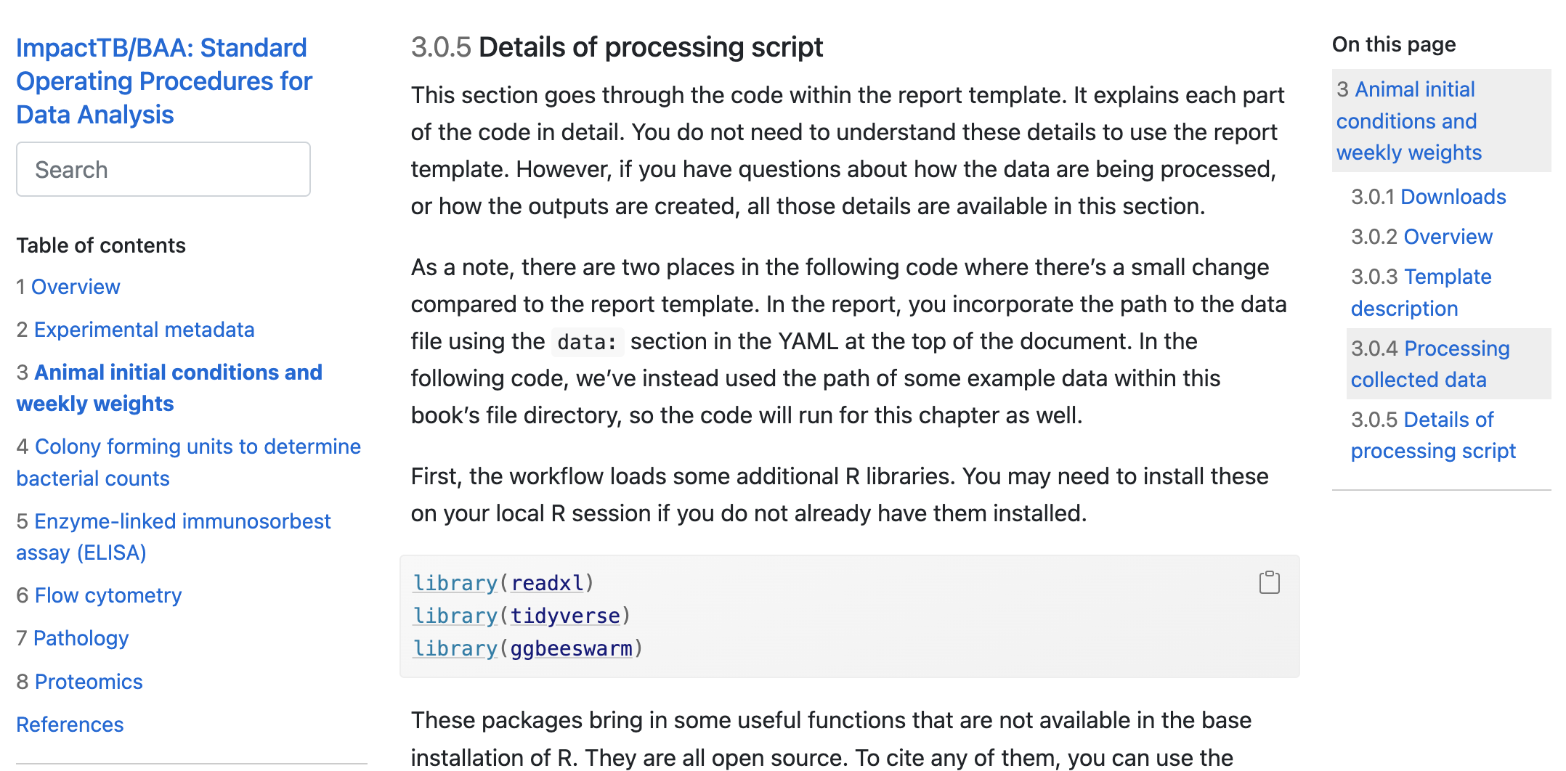
How to use the templates
https://csu-impactb.github.io/CODING-TEAM-BOOKDOWN-/animal-initial-conditions-and-weekly-weights.html

Slide 25
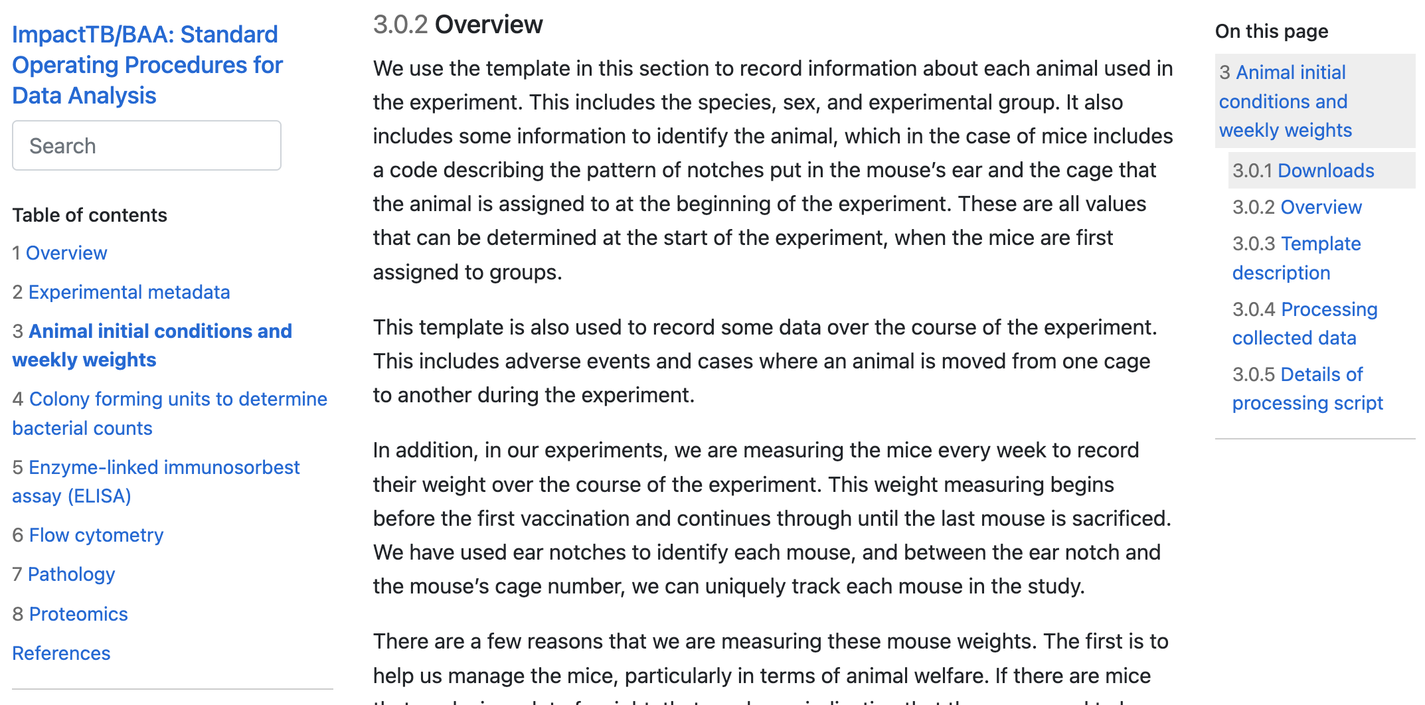
How to use the templates
https://csu-impactb.github.io/CODING-TEAM-BOOKDOWN-/animal-initial-conditions-and-weekly-weights.html

Slide 26
Continuing work on early part of pipeline
Create a web “dashboard” for the report from the report template file, rather than a static Word document
Automate so data can be stored in common lab storage (RStor, Microsoft Teams) and report will be generated based on recent saved data
Integrate and respond to suggestions by Seattle team

Slide 27
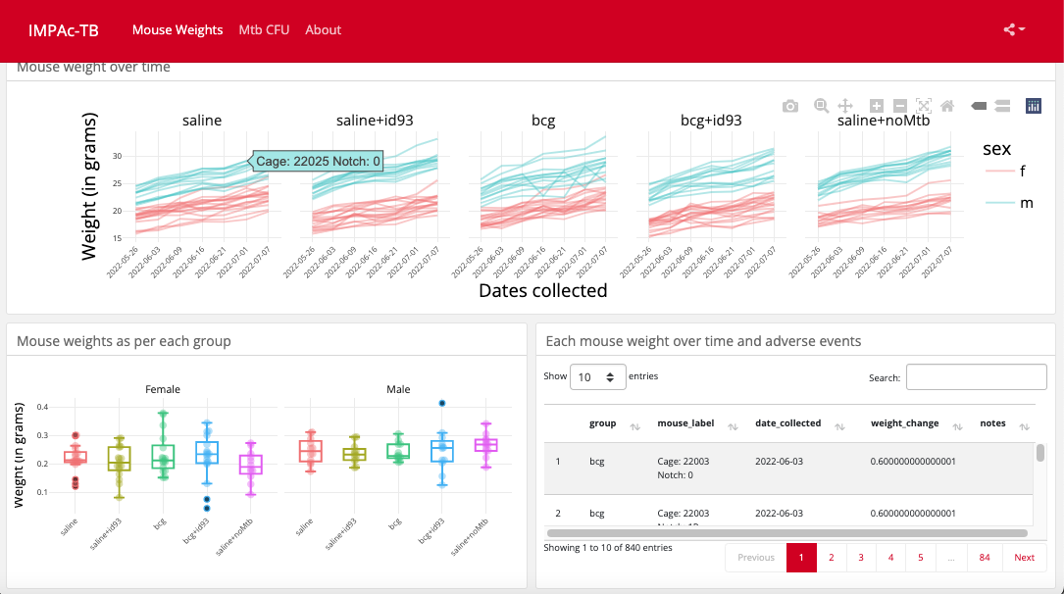
Report dashboard

Slide 28
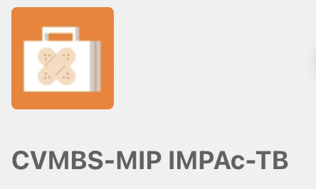
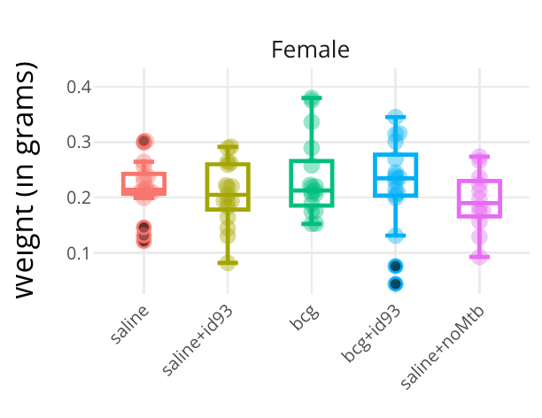

Tracking mouse weight live by connecting to Microsoft Teams
Data visualization and live data tracking
Data cleaning and Processing
Files
Body weight

Slide 29
Later steps
Standardize to allow integration across CSU experiments (CDISC / SDTM–style data model)
Standardize to share across institutes for the project (ImmPort-appropriate data model)
Use ImmPort to store data from all institutes and to share the data following publication
R package allows access to ImmPort data through an API, allowing us to work flexibly with data stored there

Slide 30
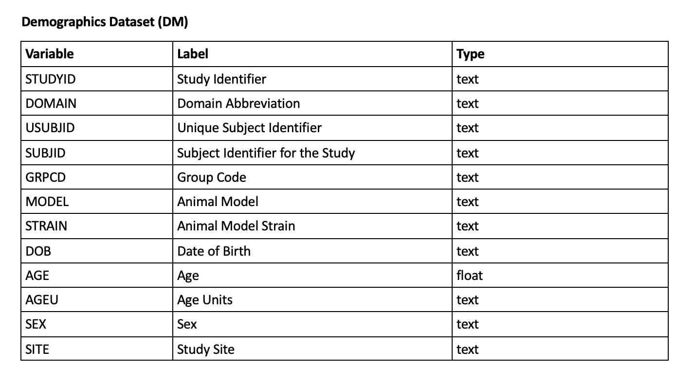
CDISC/STDM: Data Organized into Domains

Slide 31
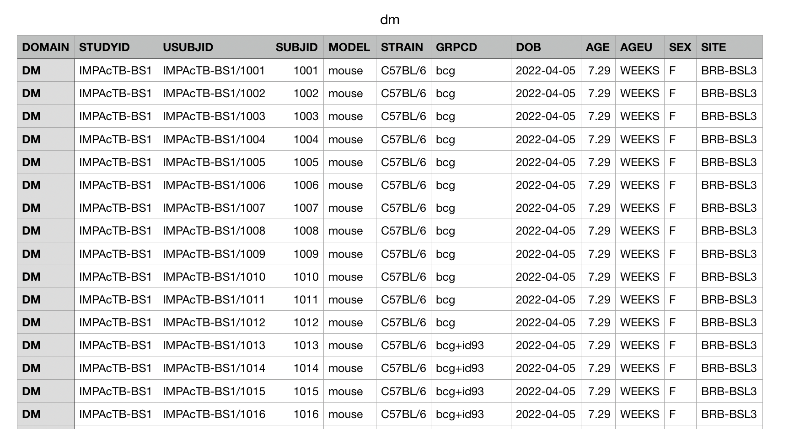
Demographics (DM)

Slide 32
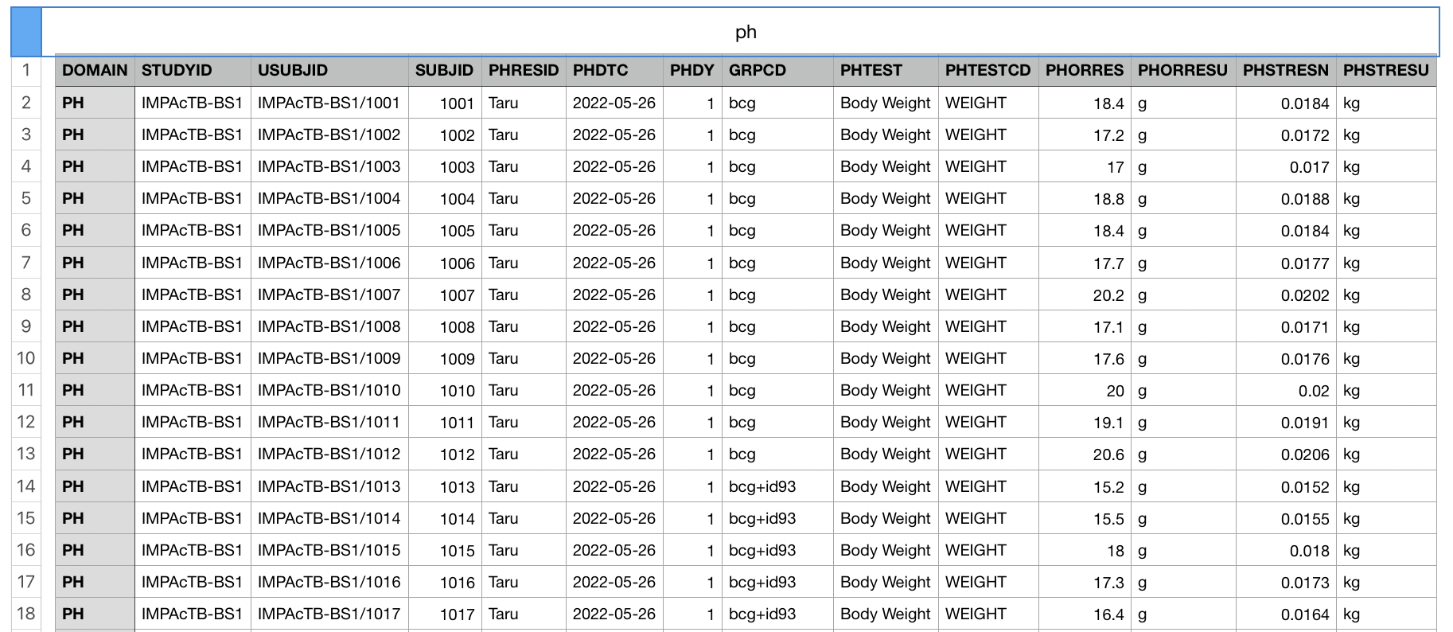
Physiology (PH)

Slide 33
Data Acquisition:
Experiments - Templates
Curation:
Reporting, statistics, QA
CDISC/STDM DB
ImmPort
Application: Public Access

